Slide 1


Call Center Performance Analysis: Insights and Improvements

Slide 2
INTRODUCTION
This presentation examines call center performance data to identify key trends, challenges, and opportunities for improvement. We'll explore customer interactions across multiple channels, analyze sentiment and satisfaction scores, and uncover patterns in call volumes and response times. By diving deep into this data, we aim to provide actionable insights that can enhance operational efficiency and customer experience in our call centers.

Slide 3

Data Source –Kaggle
Business Problem
Our analysis is based on a comprehensive dataset from our call center operations, containing information on call reasons, timestamps, channels, response times, and customer satisfaction scores. The primary business problem we're addressing is how to improve overall call center performance and customer satisfaction while optimizing resource allocation.
1
Dataset Overview
2
Key Metrics
3
Business Objectives
Includes call details, customer sentiment, and CSAT scores
Call volumes, response times, and satisfaction ratings
Enhance customer experience and operational efficiency

Slide 4
Tools and Technologies used
Jupyter Notebook
Pandas
DuckDB
Seaborn
Matplotlib

Slide 5

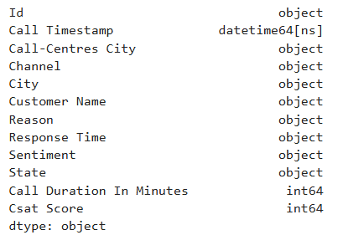
Data Cleaning and Preparation
To ensure data quality and consistency, we performed several cleaning and preparation steps:
1
Handle Missing Values
Filled missing CSAT scores with median
values
2
Convert Data Types
Converted CSAT scores to integers and timestamps to datetime format
3
Standardize Column Names
Converted to lowercase and replaced
spaces with underscores
4
Remove Duplicates
Eliminated duplicate entries to ensure data
accuracy

Slide 6
DATA ANALYSIS AND VISUALISATION

Slide 7
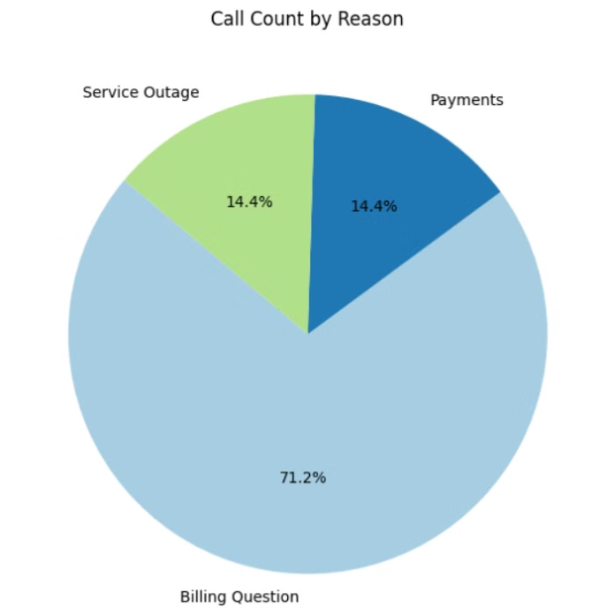
Call Reason Analysis
Our analysis of call reasons revealed that billing questions dominate customer inquiries:
Billing Questions
71.22% of all calls, indicating a significant area of customer concern
Payments
14.42% of calls, the second most common reason for customer contact
Service Outage
14.36% of calls, a notable issue affecting customer satisfaction
Implications
This distribution suggests that improving billing processes and providing more self-service options for billing inquiries could significantly reduce call volume and improve customer experience. Payments and service outages are also significant, though less frequent.

Slide 8
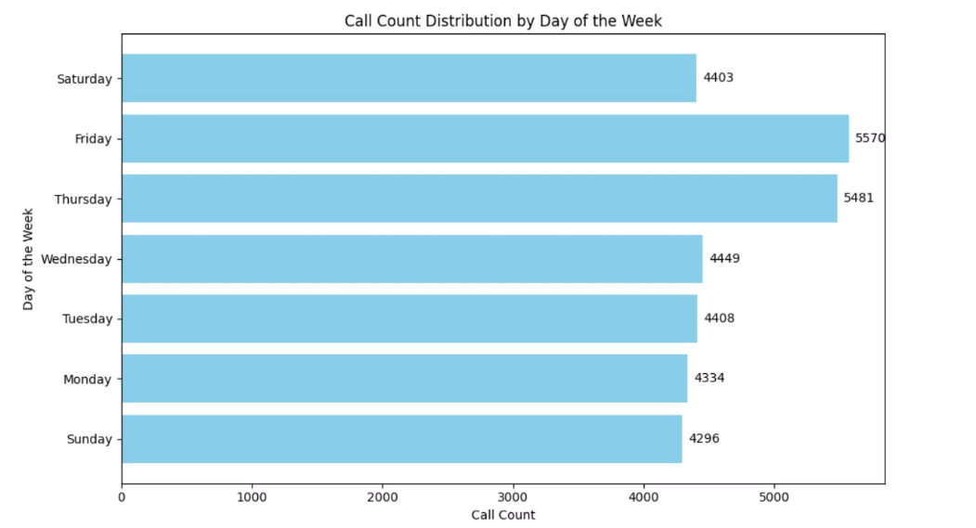
Call Volume by Day
Our analysis of call volumes revealed
Interesting patterns across days of
the week :
Busiest Days
Friday (5,570 calls) and Thursday (5,481 calls) see the highest call volumes.
Weekend Patterns
Sunday (4,296 calls) records the lowest call volume which is typical for weekends.
Implications
Staffing levels should be adjusted for busier days. Call volume peaks on Thursdays and Fridays, suggesting that these are high-demand days for the call center. Sundays have the lowest call volume, which could be used to balance staffing and resources.

Slide 9
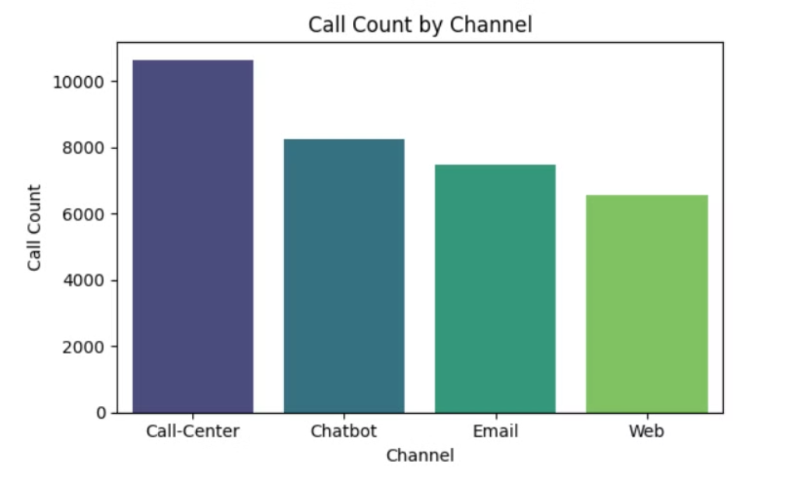
Call Volume by Channel
Channel Distribution
Call Center: 10,639 calls
Chatbot: 8,256 calls
Email: 7,470 calls
Web: 6,576 calls
Implications
The call center is the primary channel for handling calls, but other channels like chatbots, Email and web forms could be enhanced to balance the load.

Slide 10
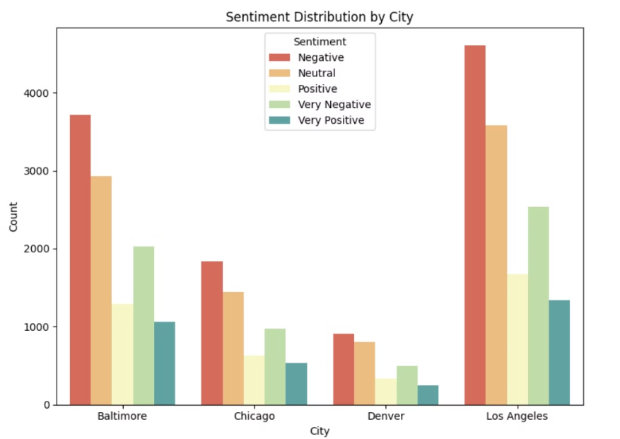
Sentiment Analysis by City
Our sentiment analysis across different cities revealed varying levels of customer satisfaction:
Baltimore:
Negative Sentiments: 3,711 calls
Very Negative Sentiments: 2,025 calls
Chicago:
Negative Sentiments: 1,839 calls
Very Negative Sentiments: 972 calls
Denver:
Negative Sentiments: 912 calls
Very Negative Sentiments: 492 calls
Los Angeles:
Negative Sentiments: 4,601 calls
Very Negative Sentiments: 2,537 calls
Implications
Los Angeles and Baltimore show higher negative sentiments, indicating a need for targeted improvements in these locations to address underlying issues causing customer dissatisfaction.

Slide 11
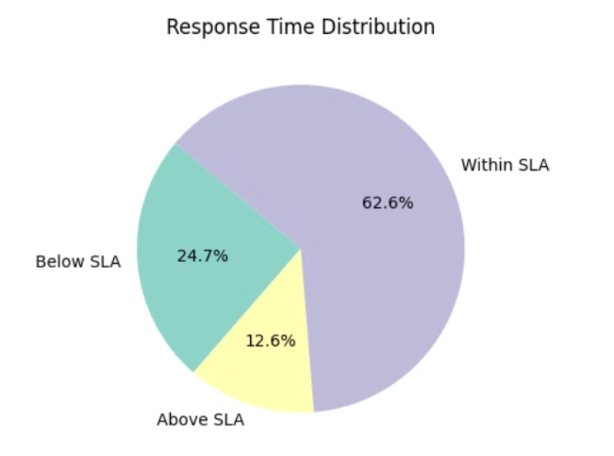



Response Time Analysis
Our analysis of response times revealed areas for improvement in meeting service level agreements (SLAs):
Within SLA
Below SLA
62.61% of calls meet the service level agreement, indicating good performance for the majority of interactions.
24.74% of calls fall below the SLA, suggesting a significant portion of calls are not being handled within the desired time frame.
Implications
Above SLA
12.65% of calls exceed the SLA, which could indicate that some calls are taking much longer than expected to respond.
A significant portion of calls fall either below or above the SLA, highlighting the need to address inefficiencies in both slow and delayed responses to enhance overall performance and improve customer satisfaction.

Slide 12





Conclusions and Recommendations
Based on our analysis, we recommend the following actions to improve call center performance:
Optimize Billing Processes
Improve billing clarity and provide more self-service options to reduce call volume.
Enhance Alternative Channels
Improve chatbot, email, and web support to balance load across channels.
Address City-Specific Issues
Implement targeted improvements in cities with high negative sentiment.
Improve Response Times
Focus on reducing the percentage of calls falling below
and above SLA.

Slide 13

Manage Peak Call Volumes
Increase staffing on Thursdays and Fridays to handle higher call volumes.
Limitations:
Our analysis is based on past data and may not account for recent changes or external factors, and subjective interpretations could influence the results.. Continuous monitoring and analysis will be crucial for ongoing improvement.

Slide 14
THANK YOU!!!

